Slide 1




NEXT GEN EMPLOYABILITY PROGRAM
Creating a future-ready workforce
Team Members
College Name
Student Name : Regina Mary B
Student ID :au711021104038
Info Institute of engineering

Slide 2

CAPSTONE PROJECT SHOWCASE
Project Title
Notes Sharing Web Application using Django Framework
Abstract | Problem Statement | Project Overview | Proposed Solution | Technology Used | Modelling & Results | Conclusion

Slide 3
Abstract
This project aims to develop a notes sharing web application using the Django framework. The application allows users to create, read, update, and delete notes, while also enabling them to share notes with other users. The system includes user authentication and permission handling to ensure secure access to notes. The application's architecture follows the Model-View-Controller (MVC) pattern, with models defining the data structure, views handling user requests, and templates rendering the interface. Additionally, the application incorporates CSS styling for an enhanced user experience. Deployment options include platforms such as Heroku, AWS, or DigitalOcean. This project serves as a practical demonstration of building a collaborative web application using Django, facilitating efficient note management and sharing among users.
Source :
github

Slide 4
Problem Statement
The objective of this project is to design and implement a comprehensive Notes Sharing Web Application using the Django framework. The existing landscape lacks a user-friendly platform for efficient note creation, management, and collaboration. This application aims to fill this gap by providing users with a seamless interface to create, edit, and share notes securely. Key features include user authentication, permission management, and robust data security measures. By addressing these challenges, the proposed solution seeks to enhance productivity and facilitate seamless collaboration among users, ultimately providing a tailored solution for effective note-sharing needs.
Source :
github

Slide 5
Project Overview
The project involves the development of a Notes Sharing Web Application using the Django framework. This application aims to provide users with a platform to create, manage, and share notes securely and efficiently. Key features include user authentication, allowing users to register and log in securely. Once logged in, users can create, edit, and delete their own notes, as well as share them with other registered users. The application also incorporates permission management, allowing note owners to specify who can view and edit their shared notes. The user interface is designed to be intuitive and responsive, ensuring a seamless user experience across devices. Additionally, robust data security measures are implemented to safeguard user data and prevent unauthorized access. Overall, the project aims to address the need for a user-friendly and secure solution for note-sharing and collaboration, enhancing productivity and knowledge sharing among users.
Source :
github

Slide 6
Proposed Solution
.
The proposed solution is to develop a Notes Sharing Web Application using the Django framework, providing users with a streamlined platform for efficient note creation, management, and collaboration. This application will feature robust user authentication mechanisms, allowing users to securely register accounts and log in. Once logged in, users will have the ability to create, edit, and delete their own notes, with each note containing fields for title, content, and timestamp. Furthermore, the application will facilitate note sharing among users, enabling individuals to share their notes with specific users or groups. Granular permission controls will be implemented to ensure that only authorized users can view and edit shared notes, with note owners retaining the ability to manage permissions. The user interface will prioritize intuitiveness and responsiveness, enhancing the overall user experience. Finally, stringent data security measures will be employed to safeguard user data and prevent unauthorized access. Through this solution, we aim to provide a comprehensive and secure platform for note-sharing and collaboration, fostering productivity and knowledge exchange among users.
Source :
github

Slide 7
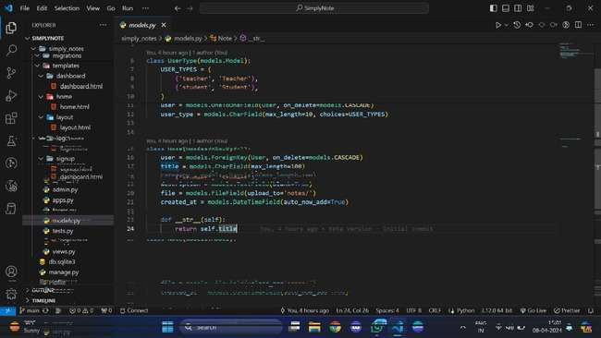
Source :
github

Slide 8
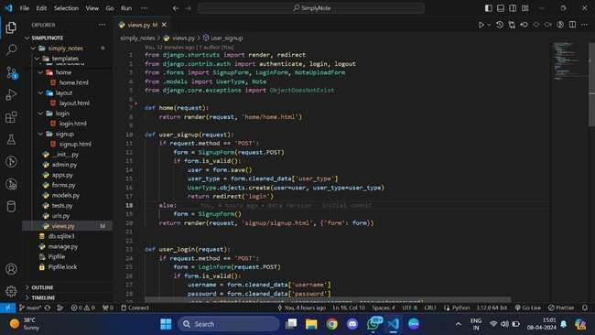
Source :
github

Slide 9


Technology Used
Front-end
Back-end
Source :
github

Slide 10
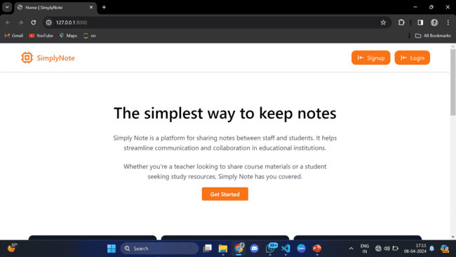
Modelling & Results
Source :
github

Slide 11
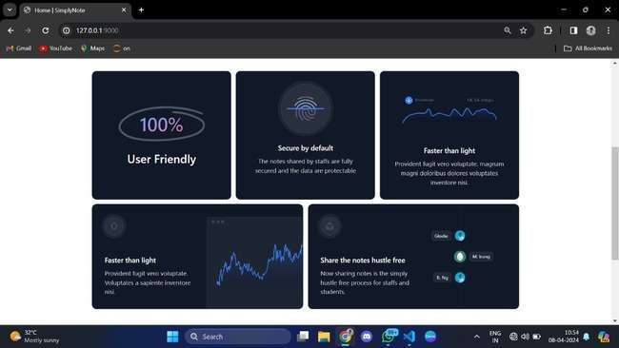
Homepage

Slide 12
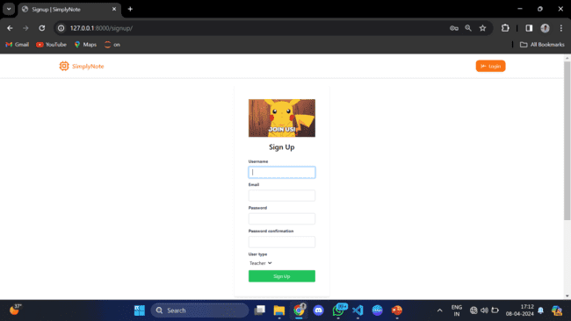
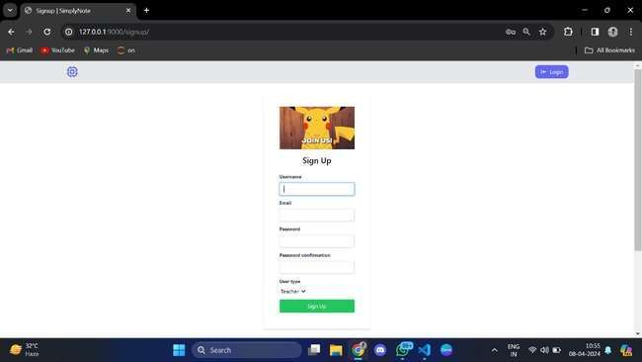
Signup-Page

Slide 13
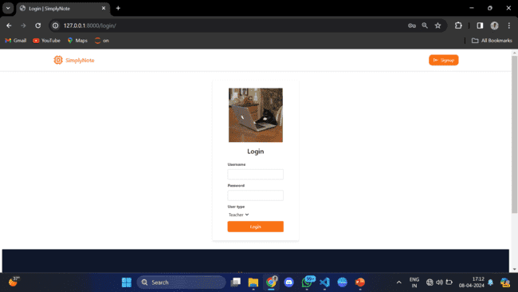
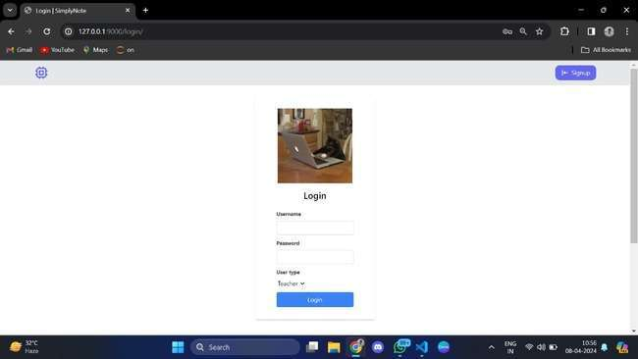
Login-Page

Slide 14
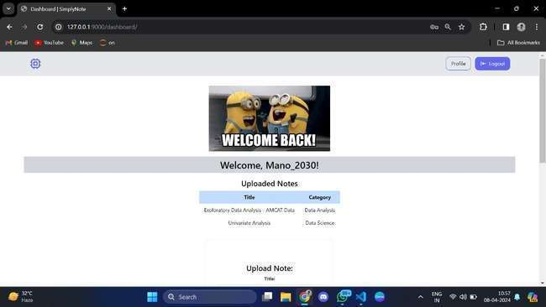
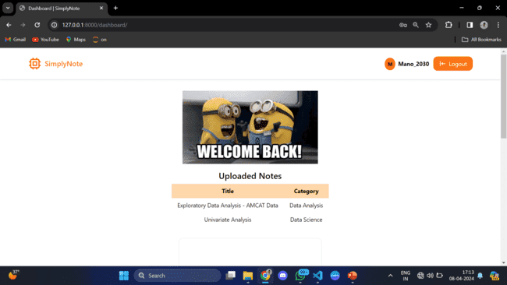
Dashboard-Page

Slide 15
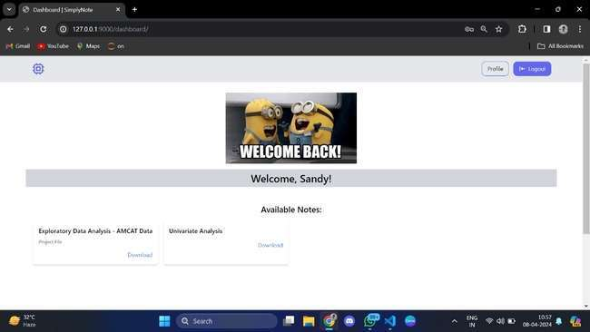
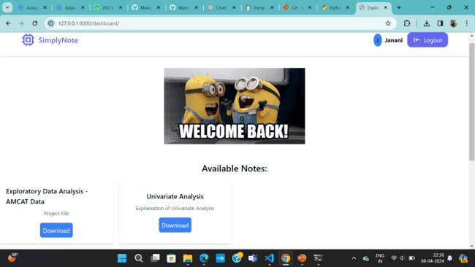
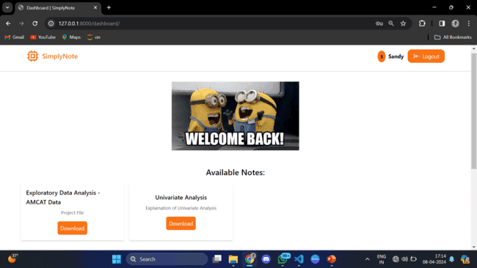

Slide 16
Future Enhancements:
For future enhancements, consider adding user profiles with additional information and a search functionality for easy note retrieval. Implement a rich text editor for formatting, and enable sharing and collaboration features. Introduce version control for notes and a notification system for updates. Ensure mobile responsiveness and allow users to tag notes for organization. Enable comments and feedback, integrate with cloud storage, and offer export/import functionality. Provide analytics on note activity and ensure accessibility and security measures. Continuously optimize performance for a seamless user experience.

Slide 17
Conclusion
In conclusion, the Notes Sharing Web Application developed using the Django Framework offers a comprehensive platform for users to create, share, and collaborate on notes. With features such as user profiles, search functionality, rich text editing, and version control, the application provides a robust and user-friendly experience. The integration of sharing capabilities, notifications, and tags enhances collaboration and organization. Moreover, the application's mobile responsiveness, security measures, and performance optimizations ensure a seamless and secure user experience. Overall, the application empowers users to efficiently manage their notes and collaborate with others, making it a valuable tool for personal and professional use.
Source :
github

Slide 18
Thank You!
Notes:
Thank You !!

